Slide 1

TSA 2021

Slide 2

Outline
TSA introduction
Time
Schedule
Department

Slide 3
What is TSA about
TSA(Trilateral Student Activity) origins in 1993，it’s an international exchanges activity held by University of Tokyo, Seoul National University and National Taiwan University every summer, the main purpose of the activity is culture and academic exchange. Not only can evolve professional ability in TSA, but also it’s a valuable chance to interact with Japanese and Korean students.
Considering the virus problem, TSA this year will be held online. There will be a main topic and host country every year. The host country this year is Korea and the main topic is untact.
Improving English conversation ability, Simulating international seminar and improving presentation skill ！

Slide 4
Time
Activity duration：8/9~8/12, 2021

Slide 5

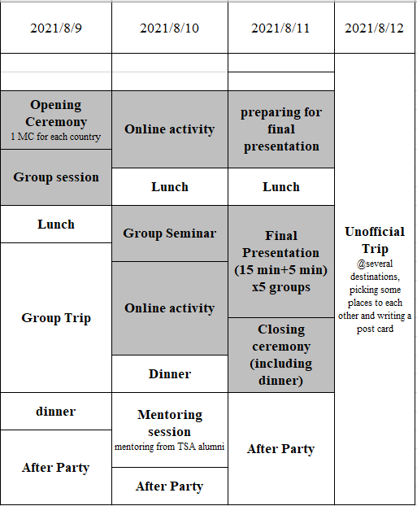
Schedule

Slide 6
Activity content
Group trip : Each department will go engineering tour and share what we learn to the other two countries.
Mentoring session : We will invite seniors that have TSA experience sharing how do they do recently, have a better knowledge the condition of civil engineering aboard.
Final presentation : Before TSA begin, each department will prepare their own presentation fitting the main topic, and merge the presentation with the other countries. At the end of the activity we will have a final presentation in English.

Slide 7

Department
About 15 people，three people each group
Structure engineering
Geotechnical engineering
Transportation
Hydraulic engineering
CAE

Slide 8
Responsible person
Coordinator : Ying 王映捷 b06501027@ntu.edu.tw
Vice Coordinator :Calvin 傅允文
b06501121@ntu.edu.tw

Slide 9

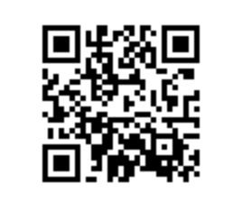
報名表單

